Slide 1
Just the Science: N-95 Masks Protect Healthcare Workers

Slide 2
The Propaganda
Particle Size
1. N-95 masks are rated to filter at 0.3 microns.
a. The COVID virus particle is about 0.1 microns.
2. Hence, it is like trying to “stop water with a chain link fence or
stopping a mosquito with a chain link fence.”

Slide 3
The Propaganda
B. Unhelpful Experts
1. Promoted the idea of herd immunity.
2. Pointed to post-pandemic statistics to present a plenary view of
the virus.
a. To make the case that the pandemic was a hoax.
3. COVID didn’t kill anybody, it was the comorbidities.
a. COVID-19 is a disease caused by a virus named SARS-CoV-2.
aa. SARS: Severe Acute Respiratory Syndrome

Slide 4
The Propaganda
By way of example: The importance of independent research.
1. Young athletes dying of cardiac arrest on playing fields was
continually reported on social media.
a. It was inferred that this was a new phenomenon linked to
COVID vaccines.
aa. Athletes dying on playing fields of cardiac arrest is a
longstanding common phenomenon: 100,000 per year
under age 30.
bb. Professional athletes do not live long lives.
(Wallach, 2023).

Slide 5
The Propaganda
The Cochrane Study
1. The go-to study by experts to establish that masks don’t work.
2. The study suggested no benefit of N-95 masks over surgical
masks.
3. Unfortunately, most clinicians did not investigate the
methodology of the study.
B. The Cochrane Library itself stated that the study was inconclusive
(Cochrane, 2020).

Slide 6
“Masks don’t work.” End of discussion?
Many experts simply say, “Masks don’t work” and leave it at that without offering any alternative. More than likely, this stance is driven by what they believe about COVID.
However, as healthcare professionals, we should know that in recent history a pandemic occurs about every 15 years (NIH, 2021).
Hence, as healthcare professionals, we need to know what works in order to be prepared for the next pandemic.

Slide 7
Experiential Evidence
The absolute best place to be infected by COVID 19 was in COVID
isolation units during the pandemic. This was NOT due to caring for
infected patients, but because...
1. Rooms were sealed with plastic zipper doors, but not negative
pressure rooms creating a viral chamber in each room.
2. COVID units were not treated as one room. This led to the
excessive donning and doffing of PPE.
3. Clinicians were routinely closer than 3ft to patients.
B. Nevertheless, facilities were able to maintain a sufficient number of
caregivers. Something worked.

Slide 8
The Science
Although-95 masks are rated to filter 0.3 micron particles, virus
particles are always attached to other particles.
1. Results in particles of 1.0 micron or larger.
Particles smaller than 0.3 microns do not travel in a straight line
(Brownian motion).
C. Viral particles are subject to electrostatic attraction produced by
N-95 masks.
Viral particles are subject to van der Waals forces.
(Litke, 2020).

Slide 9
The Science
Reduction of viral load.
1. Masks reduce viral load resulting in minor symptoms or no
symptoms at all (UCSF, 2020).
Reduction of viral load results in micro-dosing real-time
immunization (UCSF, 2020).
1. Used against smallpox in the 16th century (UCSF, 2020).
C. Effects of raised co2 levels needs further investigation.

Slide 10
Conclusion
Primarily, properly fitted N-95 masks supply significant protection against respiratory viruses because of their filtering abilities. Consideration of particle size alone is inept in the conversation because of Brownian motion, electrostatic attraction, and van der Waals forces.
An important conclusion can be determined by the science behind N-95 masks; frontline healthcare workers can depend on them for protection against respiratory viruses.

Slide 11
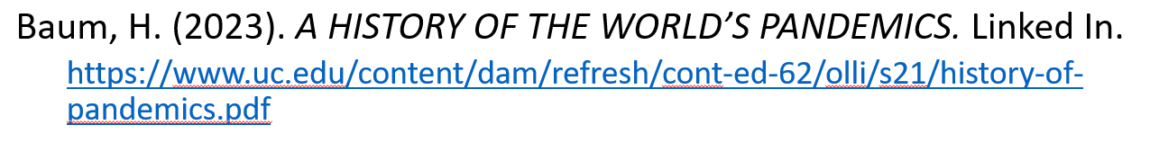
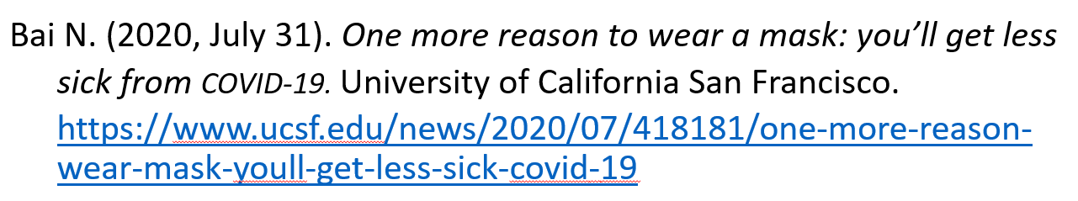
References

Slide 12
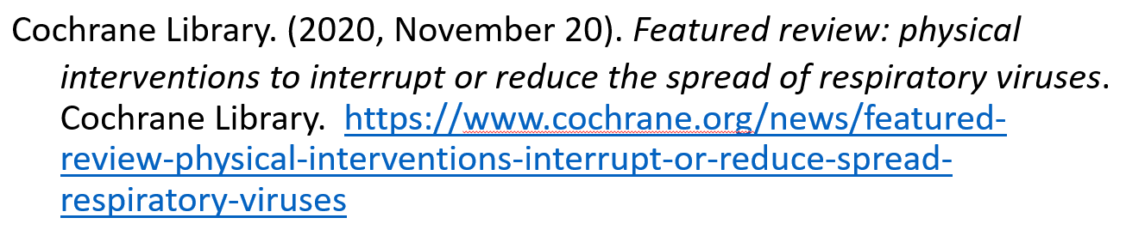
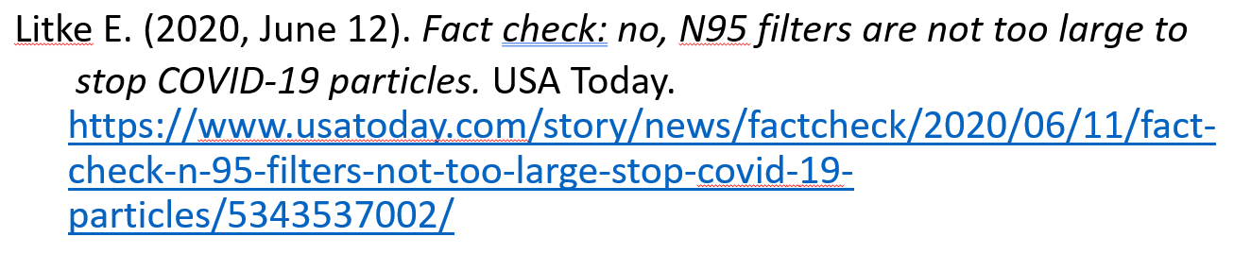
References

Slide 13
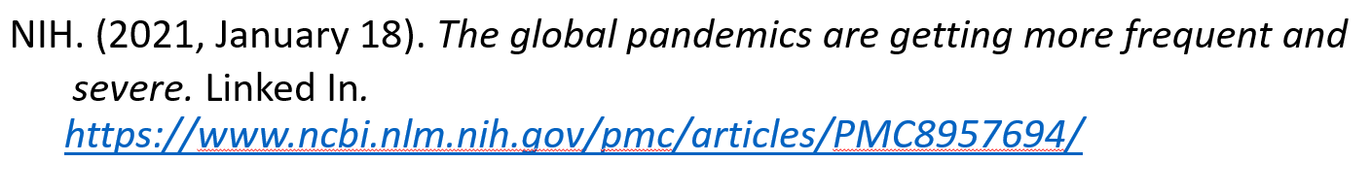
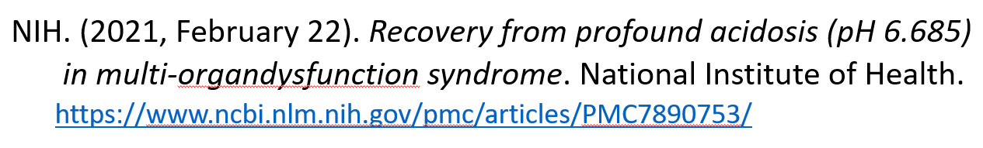

References

